Slide 1
텔레그램
테레그렘 봇

Slide 2
Botfather 검색하여 시작
BotFather, [03.08.19 12:40]
I can help you create and manage Telegram bots. If you're new to the Bot API, please see the manual (https://core.telegram.org/bots).
You can control me by sending these commands:
/newbot - create a new bot
/mybots - edit your bots [beta]
Edit Bots
/setname - change a bot's name
/setdescription - change bot description
/setabouttext - change bot about info
/setuserpic - change bot profile photo
/setcommands - change the list of commands
/deletebot - delete a bot
Bot Settings
/token - generate authorization token
/revoke - revoke bot access token
/setinline - toggle inline mode (https://core.telegram.org/bots/inline)
/setinlinegeo - toggle inline location requests (https://core.telegram.org/bots/inline#location-based-results)
/setinlinefeedback - change inline feedback (https://core.telegram.org/bots/inline#collecting-feedback) settings
/setjoingroups - can your bot be added to groups?
/setprivacy - toggle privacy mode (https://core.telegram.org/bots#privacy-mode) in groups
Games
/mygames - edit your games (https://core.telegram.org/bots/games) [beta]
/newgame - create a new game (https://core.telegram.org/bots/games)
/listgames - get a list of your games
/editgame - edit a game
/deletegame - delete an existing game

Slide 3
서 정식, [03.08.19 12:43]
/newbot
BotFather, [03.08.19 12:43]
Alright, a new bot. How are we going to call it? Please choose a name for your bot.
BotFather, [03.08.19 12:44]
Good. Now let's choose a username for your bot. It must end in `bot`. Like this, for example: TetrisBot or tetris_bot.
서 정식, [03.08.19 12:44]
서정식봇테스트
BotFather, [03.08.19 12:46]
Sorry, this username is already taken. Please try something different.
서 정식, [03.08.19 12:46]
codeSmith_bot
서 정식, [03.08.19 12:50]
seojs_bot
BotFather, [03.08.19 12:50]
Done! Congratulations on your new bot. You will find it at t.me/seojs_bot. You can now add a description, about section and profile picture for your bot, see /help for a list of commands. By the way, when you've finished creating your cool bot, ping our Bot Support if you want a better username for it. Just make sure the bot is fully operational before you do this.
Use this token to access the HTTP API:
982668519:AAGz0lvnGgPdKufSPO3Rr4up13EMj2UYEos
Keep your token secure and store it safely, it can be used by anyone to control your bot.
For a description of the Bot API, see this page: https://core.telegram.org/bots/api

Slide 4
https://core.telegram.org/bots/api
Making requests
All queries to the Telegram Bot API must be served over HTTPS and need to be presented in this form: https://api.telegram.org/bot<token>/METHOD_NAME. Like this for example:
https://api.telegram.org/bot123456:ABC-DEF1234ghIkl-zyx57W2v1u123ew11/getMe We support GET and POST HTTP methods. We support four ways of passing parameters in Bot API requests:

Slide 5
https://api.telegram.org/bot982668519:AAGz0lvnGgPdKufSPO3Rr4up13EMj2UYEos/getme
https://api.telegram.org/bot982668519:AAGz0lvnGgPdKufSPO3Rr4up13EMj2UYEos/getupdates

Slide 6
https://api.telegram.org/bot982668519:AAGz0lvnGgPdKufSPO3Rr4up13EMj2UYEos/getupdates?offset=815887564
https://www.python.org/downloads/release/python-374/

Slide 7
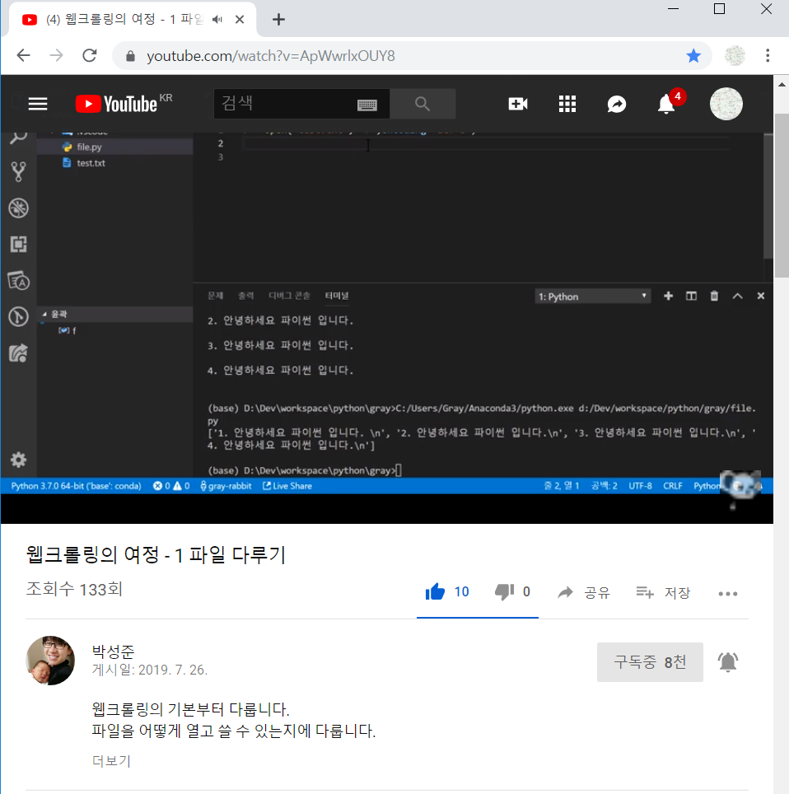
PYTHON
웹크롤링의 여정 - 1 파일 다루기
https://youtu.be/ApWwrlxOUY8

Slide 8
PYTHON

